Slide 1
Build immunity and maintain health for the days ahead
Planning and Preparing to

Slide 2
The Starting Line
YOU ARE HERE!
“...let us run with endurance the race that is set before us...” Heb. 12:1
Be intentional now to
Build HEALTH and IMMUNITY to face the days ahead.

Slide 3
The Starting Line
Eat less.
Eat healthier.
Exercise more.

Slide 4
The Good News
Every system in our body renews itself on a continual basis.

Slide 5
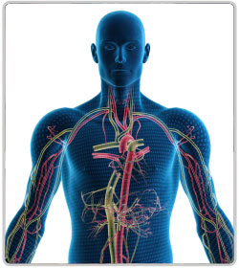
The Immune System
Your defense against the antigens of the world.

Slide 6
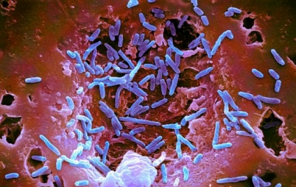
Purpose of the Immune System
Protects us against:
Billions of bacteria
Viruses
Toxins
Free radicals
Other parasites

Slide 7
Maintain a Healthy Lifestyle
Drink plenty of pure water
Exercise regularly
Sleep 8 Hours per night
Manage Stress and stop negative thought patterns
Lighten your toxic burden
Eat nutrient dense foods

Slide 8
Drink Plenty of Pure Water

Slide 9
Get Plenty of Exercise

Slide 10
Sleep 8 Hours a Night

Slide 11
Manage Stress and Stop Negative Thought Patterns

Slide 12
Lighten Your Toxic Burden

Slide 13
Eat Nutrient Dense Foods
A high calorie diet slows down your immune system.
Sugar lowers your body’s defenses.

Slide 14
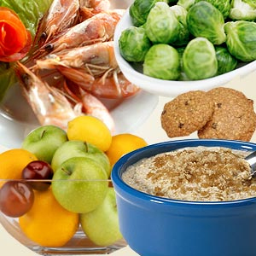
The Nutrient Challenge
Adequate intakes of micronutrients are required for the immune system to function efficiently.
(British Journal of Nutrition)

Slide 15
Nutrient Depletion of Apples

Slide 16
Nutrient Depletion of Vegetables

Slide 17
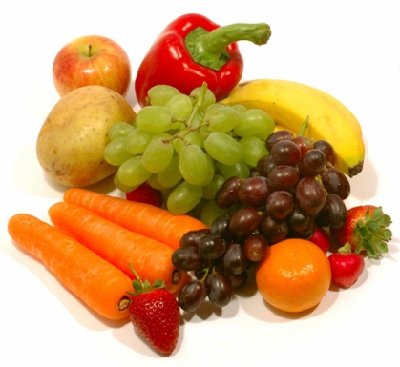
Are Supplements Necessary?
“If people eat wild, fresh, organic, local, non-genetically modified food grown in virgin mineral- and nutrient-rich soils that has not been transported across vast distances and stored for months before being eaten . . .
Dr. Mark Hyman, “The UltraMind Solution: Fix Your Broken Brain by Healing Your Body First”

Slide 18
Are Supplements Necessary?
. . . If they work and live outside, breathe only fresh unpolluted air, drink only pure, clean water, sleep nine hours a night, move their bodies every day, and are free from chronic stressors and exposure to environmental toxins, then it is possible they will not need supplements.”
Dr. Mark Hyman, “The UltraMind Solution: Fix Your Broken Brain by Healing Your Body First”

Slide 19
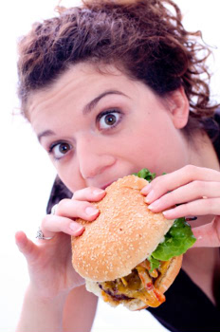
Are Supplements Necessary?
Because we live in a fast-paced society where we pick up food on the fly, skip meals, eat sugar-laden treats, buy processed foods, and eat foods that have been chemically treated, we could all use a little help from a vitamin/mineral supplement.
Dr. Mark Hyman, “The UltraMind Solution: Fix Your Broken Brain by Healing Your Body First”

Slide 20
Consider Taking and Storing High Quality Supplements
Good full-spectrum multiple vitamin
Fish Oil / Omega 3 fatty acids
Vitamin D
Antioxidants
Probiotics

Slide 21
Good Full-spectrum Multiple Vitamin

Slide 22
Fish Oil / Omega 3 Fatty Acids
Deficiencies contribute to:
Heart disease
Arrhythmias
Kidney disease
Psoriasis
High blood pressure
Inflammatory bowel disease
Some forms of cancer
Reduced immune function
Macular Degeneration
Arthritis
Diabetes
Asthma
ADD/HD
Schizophrenia
Depression
Alzheimer’s
Bipolar disorder
Neuropathy

Slide 23
Vitamin D

Slide 24
Antioxidants

Slide 25
Probiotics
The enemies of good intestinal bacteria:
Antibiotics
Birth Control Pills
NSAIDS (Nonsteroid anti-inflammatory drugs)
Steroid Drugs
Chemo Drugs
Chlorinated Water
Poor diets loaded with sugar and white flour
In 1994, the World Health Organization deemed probiotics to be the next-most important immune defense system when commonly prescribed antibiotics are rendered useless.
ANTI = “AGAINST” BIOTIC = “LIFE”
Antibiotic means “Against Life”
PRO = “FOR” BIOTIC = “LIFE”
Probiotic means “For Life”

Slide 26
Natural Probiotics
Good bacteria helps with digestion, plus stops and prevents yeast infections.
Studies show fermented cabbage has compounds that may prevent the growth of cancer.

Slide 27
New Concerns about Antibiotic Resistance
Even though there has been a decline of infectious diseases over the last 60 years, bacteria are becoming increasingly resistant to existing drugs. Many antibiotics are no longer effective at combating common diseases.
London School of Economics and Political Science (LSE)

Slide 28
New Concerns about Antibiotic Resistance
JAMA reports that invasive, serious MRSA infections occur in approx. 94,000 persons each year and are associated with 19,000 deaths. Of these infections, about 86% are healthcare-associated and 14% are community-associated.
MRSA is on the increase: In intensive care units in the US 2% of infections were MRSA in 1974, 22% in 1995, and 64% in 2004.
Klevens RM. Et al. Clinical Infectious Diseases 2006;42:389-91
1 in every 22 persons checking into a hospital acquire a hospital induced infection (HAI). Center for Disease Control Report, 2009

Slide 29
SilverSol
A New Technology to Boost Immunity and Fight Disease
SilverSol Destroys:
Bacteria
Viruses
Mold
Fungus
Yeast
Protozoa

Slide 30
Historical Uses of Silver

Slide 31
What Makes SilverSol Unique?
Typical drugs or antibiotics are effective against six or seven microbes, SILVER IS EFFECTIVE AGAINST MORE THAN 500 DIFFERENT DISEASE-CAUSING PATHOGENS without encouraging drug resistance, without any side effects, and without destroying the good bacteria in your body.

Slide 32
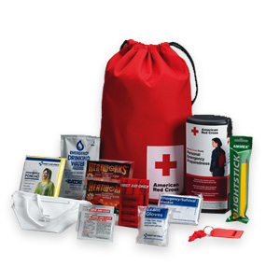
Why SilverSol is Important for Emergency Preparedness
“Silver can protect us from epidemic outbreaks, contagious diseases, and even bio-terrorist attacks by defeating the root of these problems—bacteria, viruses, and mold.” - Dr. Gordon Pedersen

Slide 33
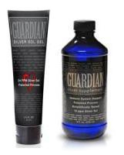
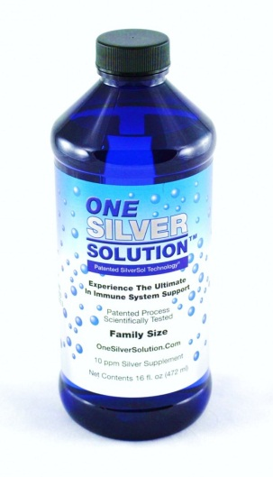
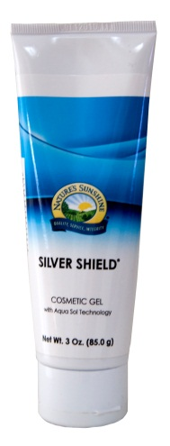
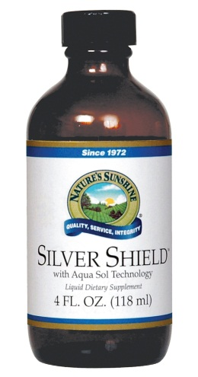
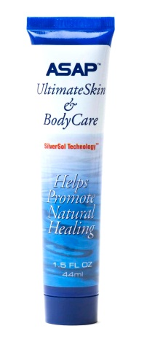
SilverSol Brands
ASAP / One Silver
Nature’s Sunshine
Guardian

Slide 34
SilverSol ppm (Parts Per Million)

Slide 35
Nature’s Pharmacy
Herbs are concentrated foods, that include; vitamins, minerals, amino acids, anti-oxidants, fiber, enzymes, phyto-nutrients vibrations and more.
Herbs help to cleanse, tone, build and nourish the body. They are not toxic chemicals and do not build up in the body with harmful residues.

Slide 36
Master Tonic
This formula is a modern day plague tonic capable of curing the most chronic conditions and stubborn diseases.

Slide 37
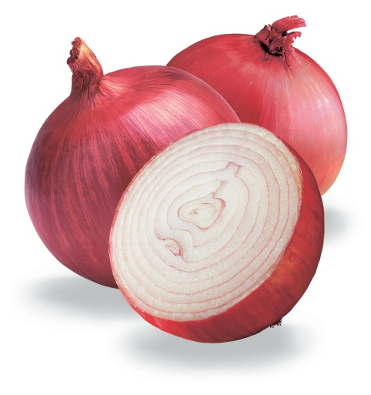
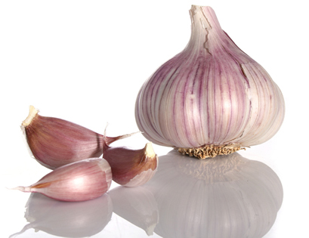
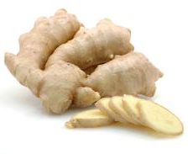
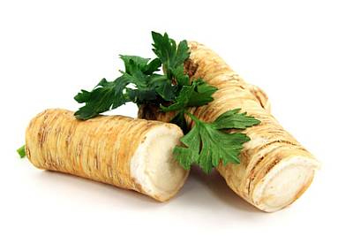
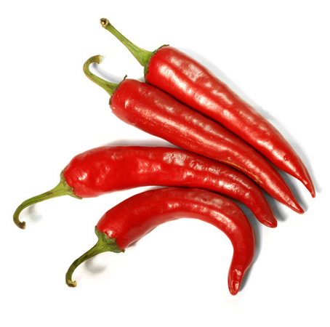
Master Tonic Ingredients

Slide 38
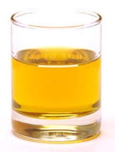
Master Tonic Dosage
1/2 to 1 ounce, two or more times daily, gargle and swallow. Not only is it the cure for the common cold, but every other disease of mankind.

Slide 39
In Conclusion . . .
Your health is a major factor to success in the days ahead.
Begin now to run the race to win!

